Slide 1


Personalized Workout Suggestion System
AN AI-BASED FITNESS PLANNER
COURSE : ARTIFICIAL INTELLIGENCE
COURSE CODE : CSE 3812
DATE : //2025
Page
1

Slide 2



Our Team
AZMAIN ELAHI
SIBGATUL HASSEN
BENJAMIN SHAH
011222289
0112230799
Marketing
Page
2

Slide 3


Introduction
What is this project about?
A smart workout suggestion system that gives users personalized fitness plans.
Uses basic AI (rule-based logic).
Designed to adapt to user profiles and progress over time.
Page
3

Slide 4


Project Goals
Provide customized workout plans based on user input.
Ensure workouts are practical for user's available equipment.
Track user progress and adjust plans accordingly.
Estimate calories burned to give health feedback.
Page
4

Slide 5
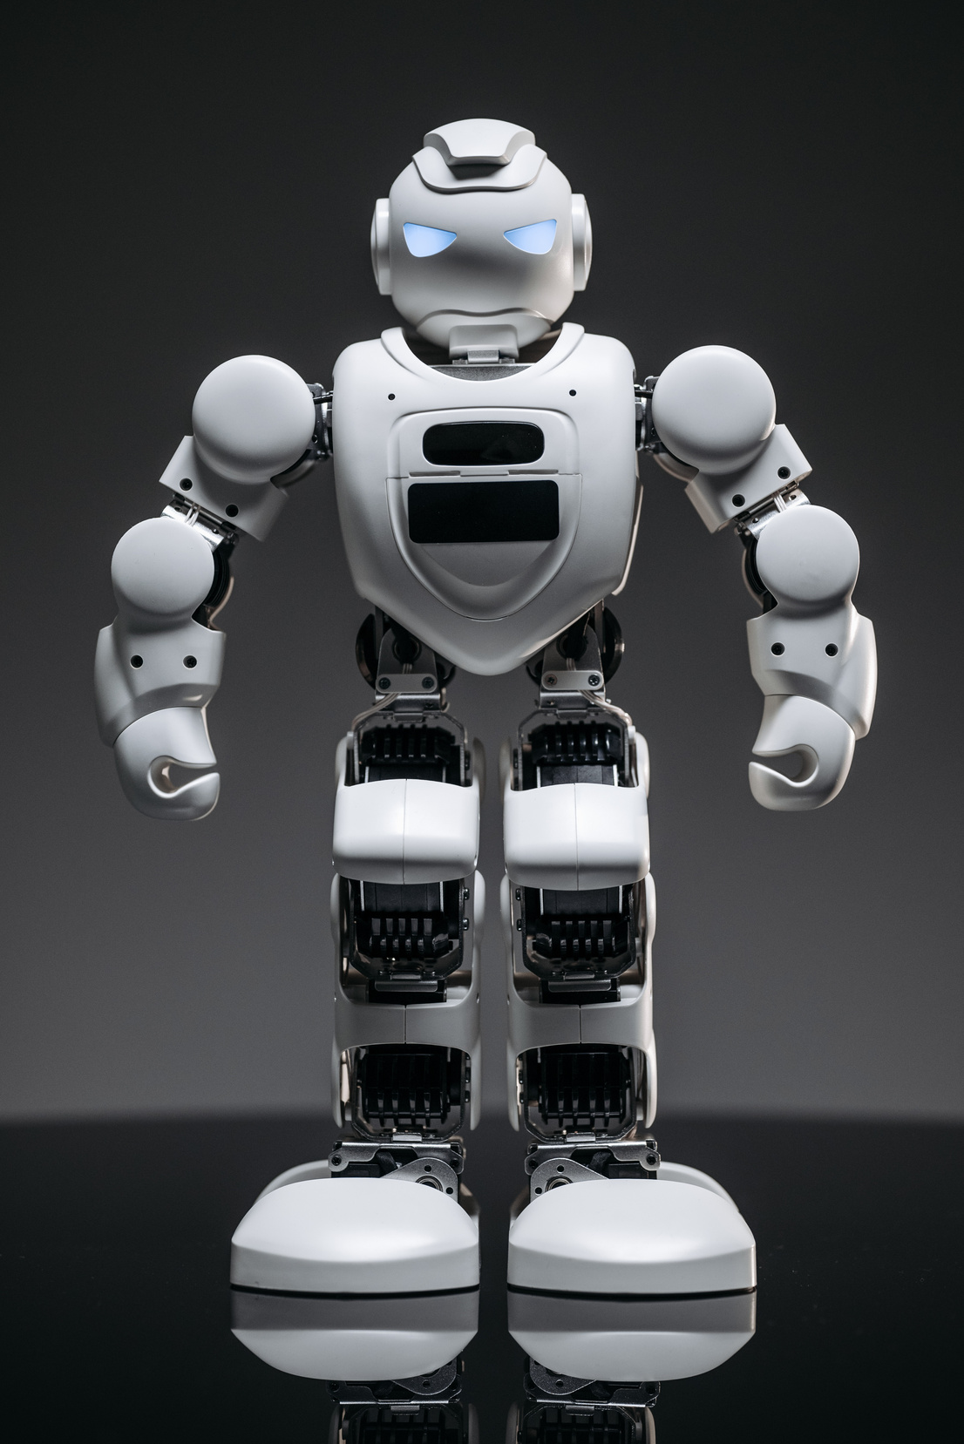
User Inputs
The system collects:
Age
Gender
Fitness Goal – Lose Weight, Build Muscle, Maintain Fitness
Equipment Available – None, Home, Gym
These inputs help tailor the workout recommendation.
Page
5

Slide 6


Rule-Based AI Logic
How the system decides the workout type:
Uses conditional statements (if-else rules).
No ML — all logic is hardcoded based on input.
Example Logic:
if goal == "Lose Weight" and equipment == "None":
plan_type = "Bodyweight Cardio"
This logic classifies the user into a workout category.
Page
6

Slide 7

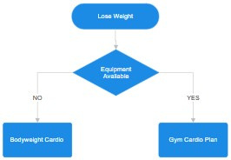
Decision Tree
Page
7

Slide 8

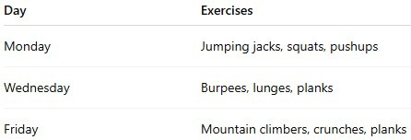


Workout Plan Recommendation
Each user gets a structured schedule:
Workout Types Offered:
Cardio
HIIT
Strength Training
Yoga / Flexibility
page
8

Slide 9


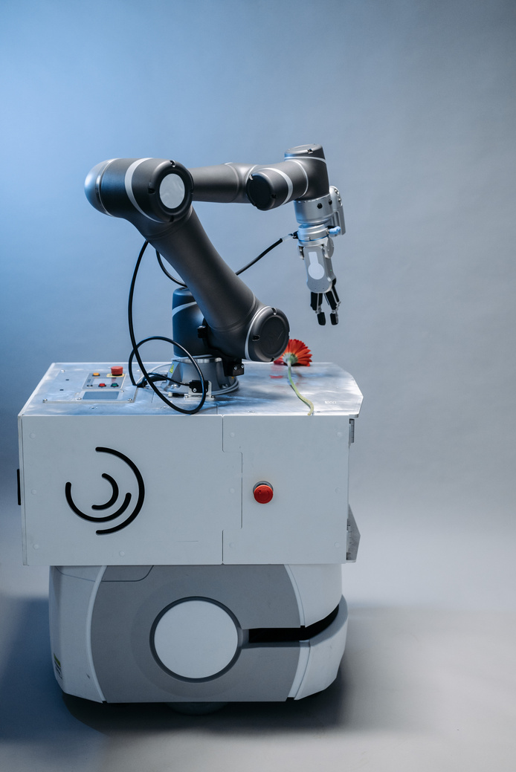
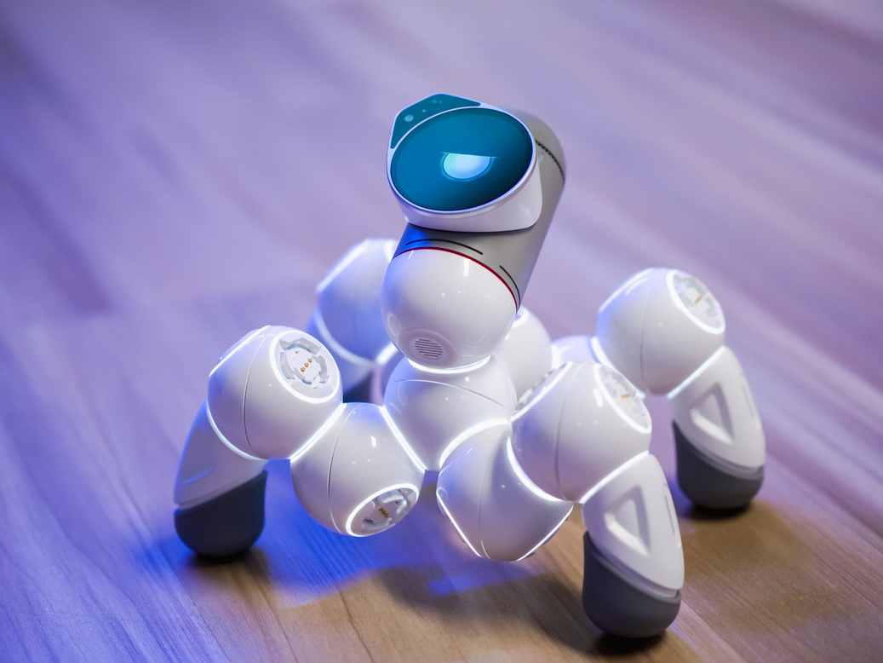
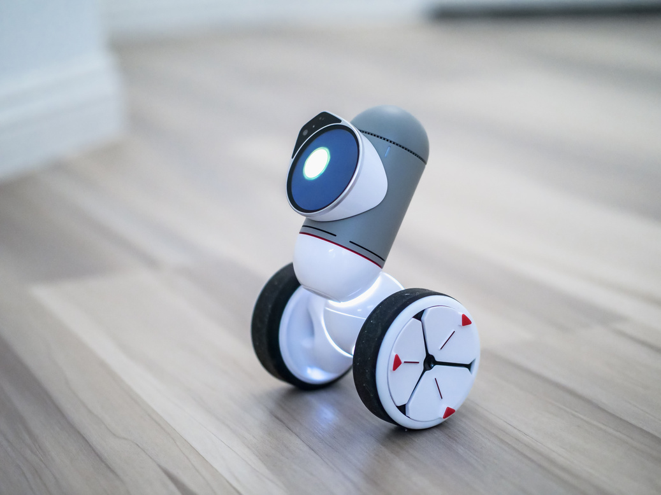
Workout Progress Tracking
User marks workouts as done/skipped.
Tracks how many sessions were completed.
Logic adjusts intensity or frequency:
Missed workouts → reduce complexity
Regular workouts → increase difficulty
Page
9

Slide 10

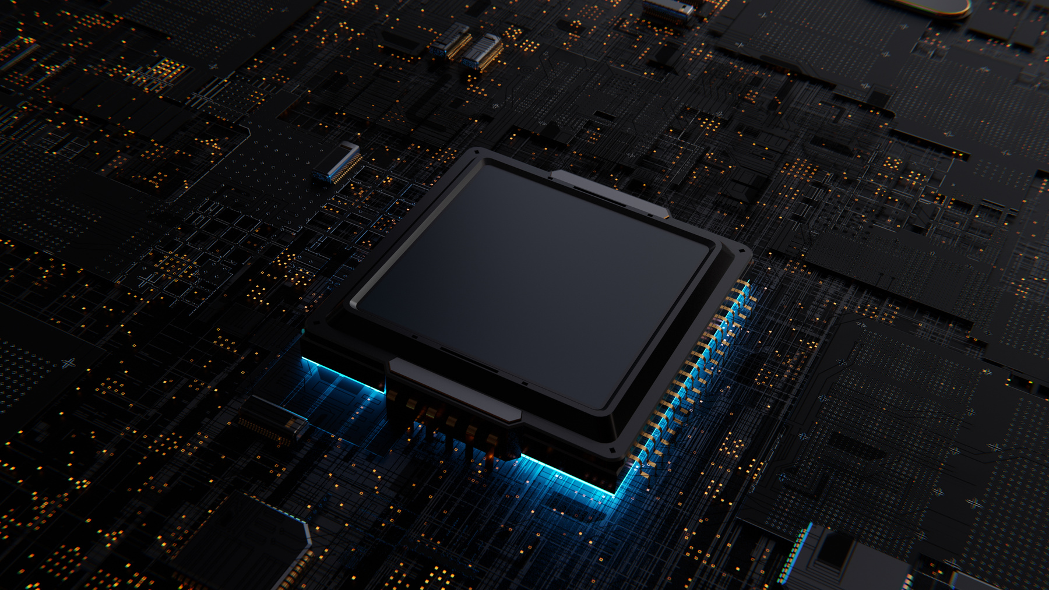
Calorie Estimation
Estimates how many calories the user burns based on:
Exercise type (Cardio, Yoga, etc.)
Duration (in minutes)
User's weight
Formula Used:
Calories = MET * 3.5 * weight / 200 * duration
Page
10

Slide 11


Tools & Technologies Used
Python – core logic and functionality
Tkinter / Streamlit / Flask – for basic user interface
Basic AI (Rule-Based System) – no ML, uses if-else logic
No external libraries required (unless UI needed)
Page
11

Slide 12


Advantages of Using Rule-Based AI
Simple and fast to implement
Works offline, no data needed
Easy to understand and modify
Great for small-scale personal or educational projects
Page
12

Slide 13
Future Enhancements
ADD USER ACCOUNTS AND DATA SAVING
INCLUDE NUTRITION AND MEAL PLANNING
INTEGRATE REAL-TIME FEEDBACK WITH WEARABLE DATA
UPGRADE TO ML-BASED CLUSTERING LATER (K-PROTOTYPES, ETC.)
BMI CALCULATOR & FITNESS MEASUREMENT
Page
13

Slide 14
Conclusion
CREATED A WORKING INTELLIGENT FITNESS PLANNER WITHOUT USING ML
PERSONALIZED WORKOUTS BASED ON INPUT AND LOGIC
ADAPTABLE AND EXPANDABLE DESIGN
A GOOD STARTING POINT FOR REAL FITNESS APPS
Page
14

Slide 15
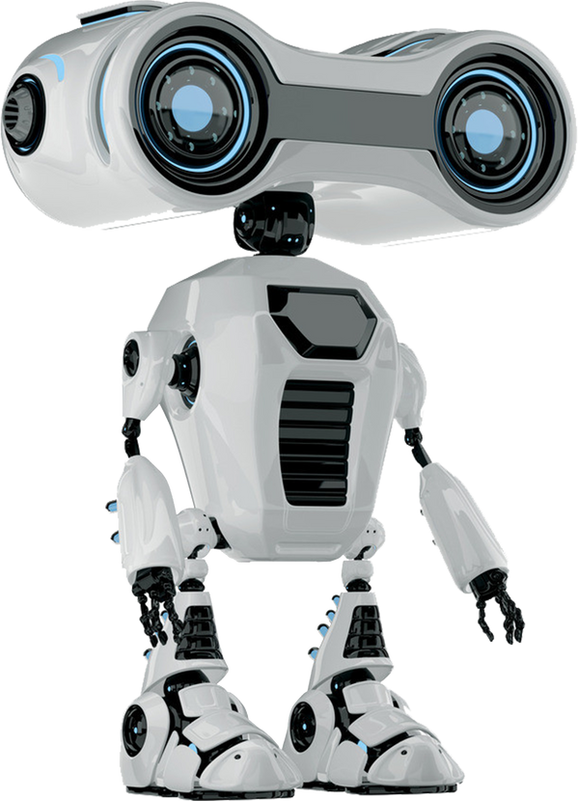
Thank You
FOR YOUR ATTENTION
Page
15

